Slide 1
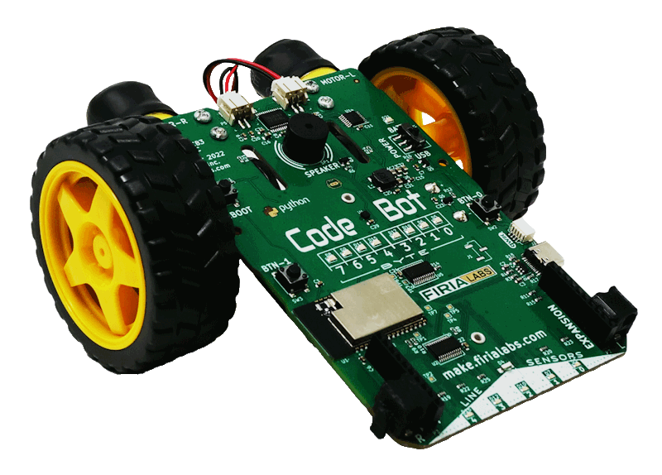
CodeBot Unit 1 Remix
Create your own project based on Mission 3

Slide 2
Time for a project remix!
A remix can be:
A new program created by adding new code to a program you already created
You can combine parts of two or more programs in a remix
Use a similar idea in a different way

Slide 3
Project Remix
Creating a remix will let you:
Improve your skills and practice the concepts from the mission.
Be creative.
Remember code from earlier programs and missions.
Work with other students.
Design an original program and write the code all on your own.

Slide 4
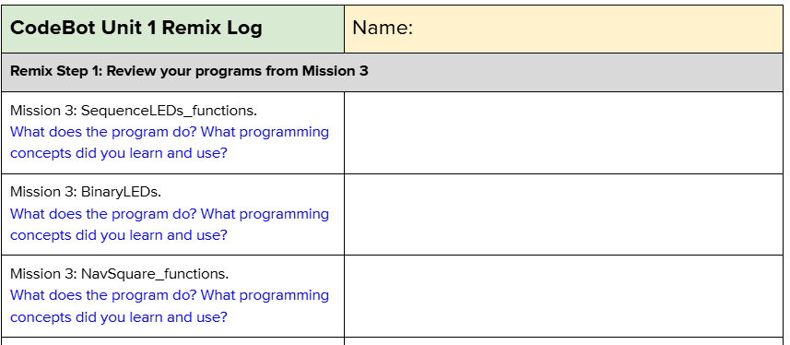
Step #1
Review Mission 3
Open your programs from Mission 3
SequenceLEDs_functions
BinaryLEDs
NavSquare_functions
DO THIS:
Fill out the information in the Planning Guide for Step 1

Slide 5
Step #2
Brainstorm ideas
Read through the mission extension ideas.
Read through remix suggestions.
You can use any of these ideas or come up with your own.

Slide 6
Step #2 Remix Ideas
Mission 3 Extensions
Using the two buttons as input:
Move the ‘bot in a large square and a small square
Move the ‘bot in a square and a diamond
Move the ‘bot in a square and a rectangle
For a challenge, move the ‘bot in two different circles.

Slide 7
Step #2 Remix Ideas
Mild
Use the binary designation for turning on LEDs, and combine that with ‘bot movement.
Medium
Light up different LEDs as the ‘bot moves, to indicate what the movement is. For example, light up user LED 0 when moving forward, and LED 7 when moving backward. Light up line sensor LEDs when turning.

Slide 8
Step #2 Remix Ideas
Medium
Program the ‘bot like a remote control – when one button is pressed, it moves one way, and a different way for the other button.
Spicy
Program the ‘bot to do a dance, with movement, lights and beeps. Code two different dances, and use a button press to select a dance.

Slide 9
Step #2
Brainstorm ideas
Read through remix suggestions
Use the suggestions –or–
Use your creativity to come up with your own idea for a project
Decide with your partner what project you will do
DO THIS:
Fill out the information in the Planning Guide for Step #2

Slide 10
Step #3
Make a plan
What variables will you need? What will you use them for?
What will you program the buttons to do?
What will you use the user LEDs and line sensor LEDs for?
Will you use the speaker? If so, when?
What are some functions you can define and use? Will they need parameters?

Slide 11
Step #3
Make a plan
DO THIS:
Fill out the information in the Planning Guide for Step #3
Add to the Planning Guide with more information, as needed.
NOTE: You can modify your plan as you begin to program. You may come across more functions to create, LED uses, and more as you go.
You do not need to revise Step 3 while you work.

Slide 12
Step #3
Make a plan
DO THIS:
Use a piece of paper to write an algorithm for your project:
What happens first?
What happens next?
This algorithm will help you get started.
What do you need to import?
Are there functions you can start with?
What happens first in the main program?
What will happen in the button presses?

Slide 13
Step #4
Code your project
IMPORTANT: In CodeSpace, go to the sandbox
Start a new file and give it a descriptive name (Remix1)
You can leave other programs open and use them as a guide
Import your modules
Define your variables
Write functions near the top of your code
Write function calls and other instructions in the main program
Write your code a little bit at a time, testing frequently

Slide 14
Step #4
Stop and test frequently!
Don’t try to write all the code at one time
Think about the steps:
Just get one thing to work, then move on
Step by step!
Mistakes happen, so find them early
Type just a few lines of code and then run the program
If there is an error, fix it before continuing
Use your other programs and classmates for help

Slide 15
Step #4
Documentation!
Make sure your code is readable by adding blank lines
Add comments to sections of your code that explain what they do

Slide 16
Step #5
Get feedback and Revise
Show your code to other students.
What do they think? Have them fill out the feedback form on your Planning Guide.
The Planning Guide has space for two people to give feedback. The feedback can come from two peers or one peer and yourself.
Use the peer reviews to modify your code and make your project even better

Slide 17
And now you have your own remix!
Congratulations!
By completing this remix you have:
learned more about programming
practiced the skills and concepts from the missions
been thinking! And problem solving and much more!

Slide 18
Mission Reflection
Wow! Great job!
Share your project with your friends!
Run projects from other students
Complete the Post-Remix Reflection in the Planning Guide

